Slide 1

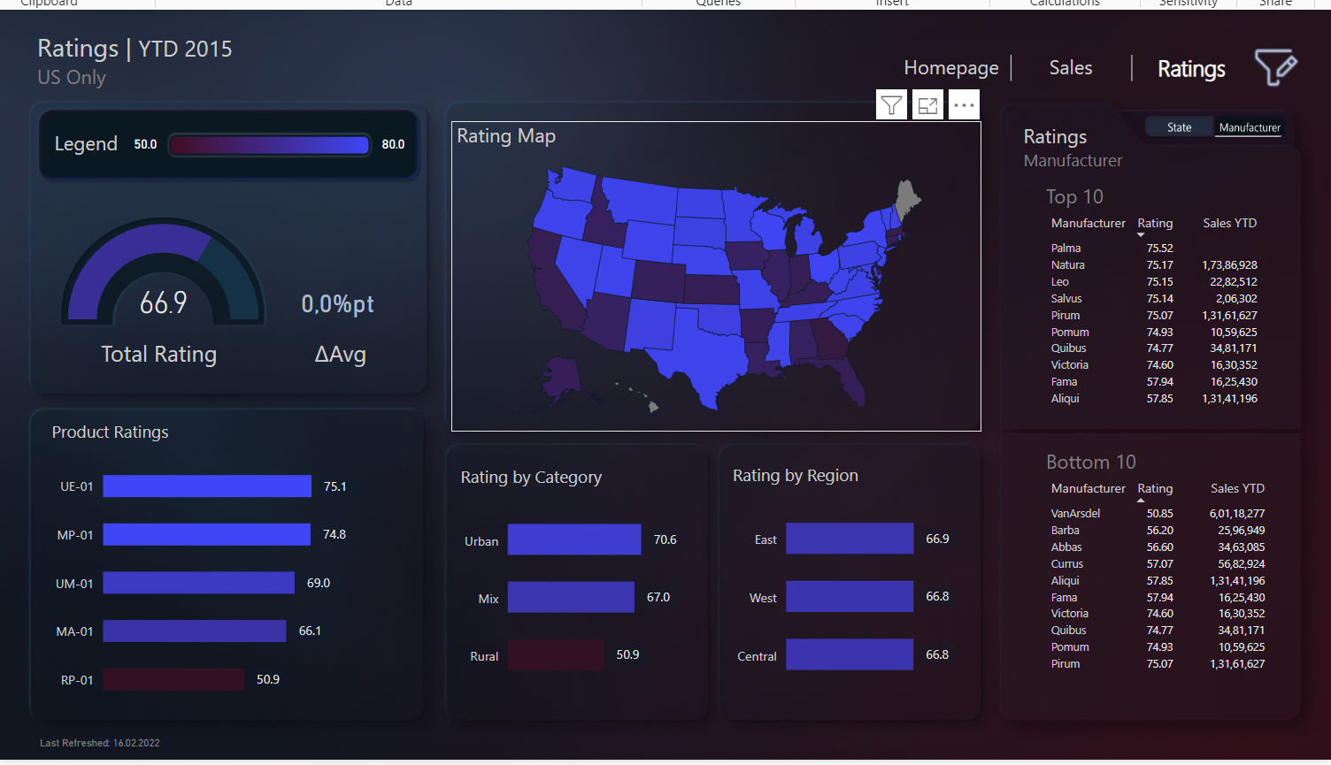
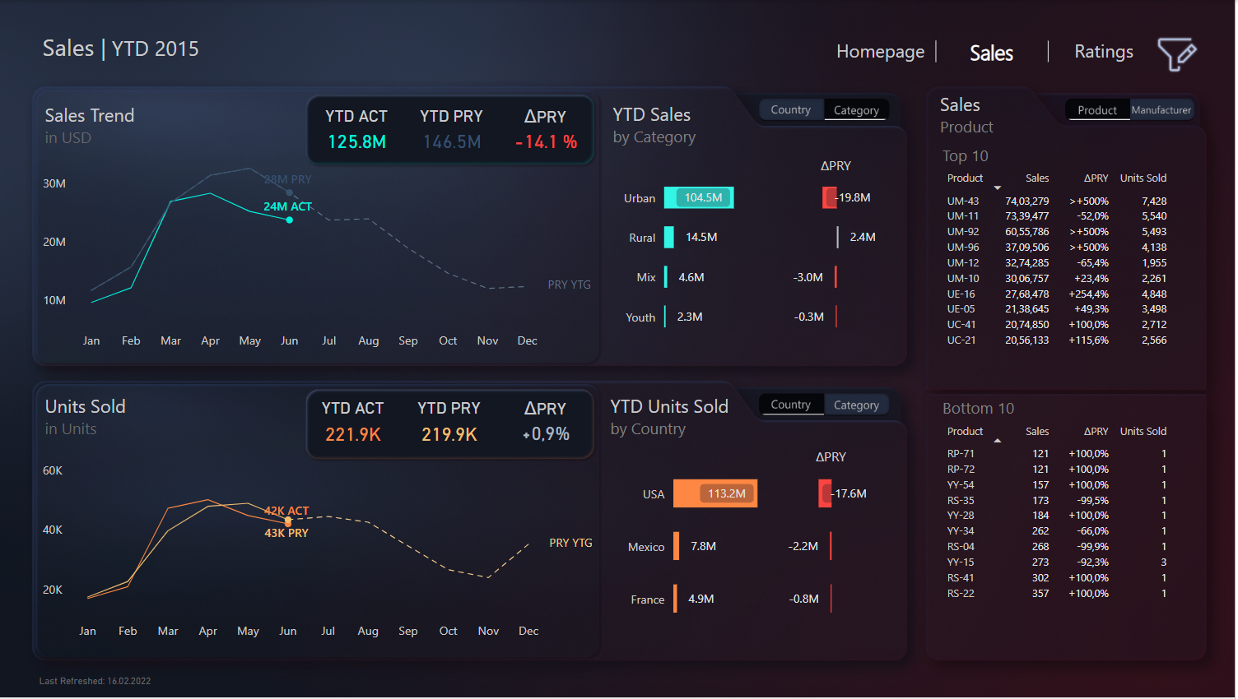


sales Analysis Dashboard
Sales Analysis Dashboard Challenge
View in Power BI
Last data refresh:
5/13/2024 4:13:06 PM UTC
Downloaded at:
5/14/2024 4:48:55 PM UTC

Slide 2

Home
Notes:
Button_Main_Icon
No alt text provided
Text box_Title
No alt text provided
Text box_main info
No alt text provided
Button_Logo
No alt text provided
Shape_Home_active
No alt text provided
Button_Home
No alt text provided
Button_Period
No alt text provided
Button_Segment
No alt text provided
Button_Country
No alt text provided
Button_Product
No alt text provided
Button_Clear_managers
No alt text provided
Slicer_manager
No alt text provided
Button_facebook
No alt text provided
Button_Youtube
No alt text provided
Button_twitter
No alt text provided
Button_instagram
No alt text provided
Button_linkedin
No alt text provided
Button_tiktok
No alt text provided
Shape_line
No alt text provided
Button_web url
No alt text provided
Button_Title_Icon
No alt text provided
Button_Net_Profit
No alt text provided
Text box_Profit
No alt text provided
card
No alt text provided
card
No alt text provided
textbox
No alt text provided
card
No alt text provided
Shape_Net_Profit
No alt text provided
Button_ico_net_profit
No alt text provided
Text box_COGS
No alt text provided
card
No alt text provided
textbox
No alt text provided
card
No alt text provided
Shape_COGs
No alt text provided
Button_Icon_COGs
No alt text provided
Button_COGs
No alt text provided
Button_Net_Sales
No alt text provided
Text box_Net sales
No alt text provided
card
No alt text provided
card
No alt text provided
card
No alt text provided
textbox
No alt text provided
card
No alt text provided
Shape_Net_Sales
No alt text provided
Button_icon_Net_Sales
No alt text provided
Text box_Unit sold
No alt text provided
card
No alt text provided
card
No alt text provided
card
No alt text provided
textbox
No alt text provided
card
No alt text provided
Shape_units_sold
No alt text provided
Button_ICON_Units_sold
No alt text provided
Button_Units_Sold
No alt text provided

Slide 3
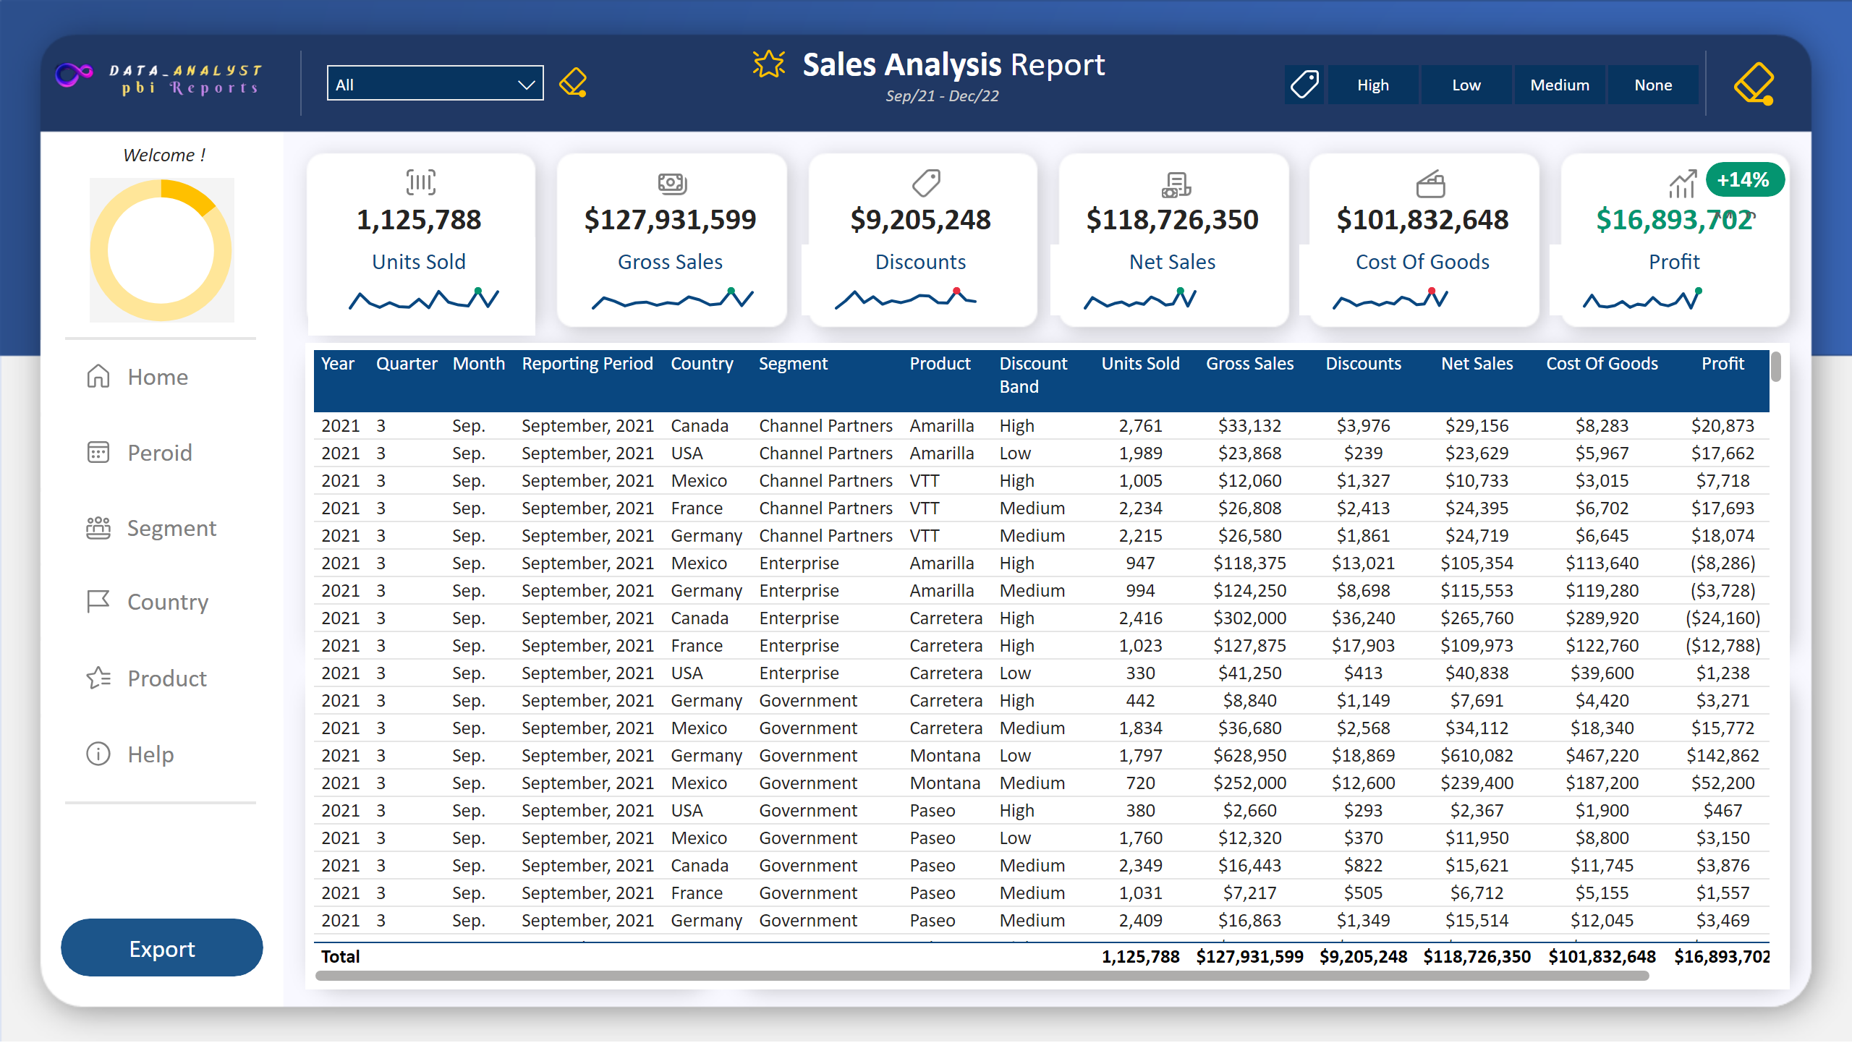
Sales Analysis
Notes:
Button_Title_Icon
No alt text provided
Slicer_manager
No alt text provided
Button_Clear_managers
No alt text provided
Button_Logo
No alt text provided
Text box_Title
No alt text provided
Card_Date_Range
No alt text provided
Button_Discount_Icon
No alt text provided
Slicer_Discounts
No alt text provided
Button_Clear_Discounts
No alt text provided
Shape_Divider_left
No alt text provided
Shape_Divider_Right
No alt text provided
Simple_Image_Mgr_image
No alt text provided
Shape_Hide_mgr_image
No alt text provided
Donut_mgr_img
No alt text provided
Card_Welcome
No alt text provided
Shape_Top_nav_divider
No alt text provided
actionButton
No alt text provided
actionButton
No alt text provided
Button_Home
No alt text provided
Button_Help
No alt text provided
Button_Peroid
No alt text provided
Button_Country
No alt text provided
Button_segment
No alt text provided
Button_Product
No alt text provided
actionButton
No alt text provided
actionButton
No alt text provided
actionButton
No alt text provided
actionButton
No alt text provided
actionButton
No alt text provided
actionButton
No alt text provided
actionButton
No alt text provided
actionButton
No alt text provided
Shape_Bottom_nav_divider
No alt text provided
Button_Export
No alt text provided
Card_Unit sold
No alt text provided
Card_Profit
No alt text provided
Card_COGS
No alt text provided
Card_Net sales
No alt text provided
Card_Discounts
No alt text provided
Card_Gross sales
No alt text provided
Button_unit_sold_icon
No alt text provided
Button_Profit_icon
No alt text provided
Button_Gross_Sales_icon
No alt text provided
Button_Discount_icon
No alt text provided
Button_Net_sales_icon
No alt text provided
Button_COGS_icon
No alt text provided
Sparkline_unit sold
No alt text provided
sparkline_gross sales
No alt text provided
Sparkline_Discounts
No alt text provided
Sparkline_net sales
No alt text provided
Sparkline_COGs
No alt text provided
Sparkline_Profit
No alt text provided
Shape_Profit_Margin
No alt text provided
actionButton
No alt text provided
actionButton
No alt text provided
actionButton
No alt text provided
actionButton
No alt text provided
Card_Profit_Mragin
No alt text provided
barChart
No alt text provided
barChart
No alt text provided
barChart
No alt text provided
columnChart
No alt text provided
barChart
No alt text provided
barChart
No alt text provided
barChart
No alt text provided
columnChart
No alt text provided
Table_Export
No alt text provided
barChart
No alt text provided
barChart
No alt text provided
barChart
No alt text provided
tableEx
No alt text provided
tableEx
No alt text provided
tableEx
No alt text provided
columnChart
No alt text provided
areaChart
No alt text provided
areaChart
No alt text provided
areaChart
No alt text provided
tableEx
No alt text provided
shape
No alt text provided
card
No alt text provided
areaChart
No alt text provided

Slide 4
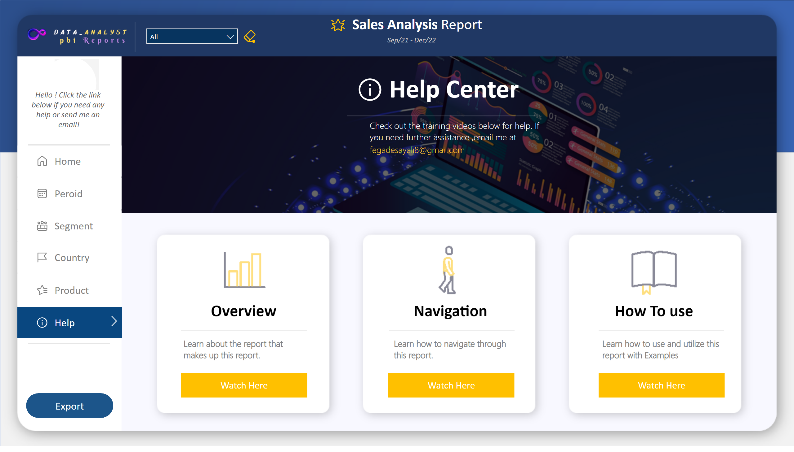
Help
Notes:
Simple_Image_Mgr_image
No alt text provided
Shape_Hide_mgr_image
No alt text provided
actionButton
No alt text provided
Button_Help_Active
No alt text provided
Card_Welcome
No alt text provided
Shape_Top_nav_divider
No alt text provided
Button_Home
No alt text provided
Button_Peroid
No alt text provided
Button_Country
No alt text provided
Button_segment
No alt text provided
Button_Product
No alt text provided
actionButton
No alt text provided
actionButton
No alt text provided
actionButton
No alt text provided
actionButton
No alt text provided
actionButton
No alt text provided
actionButton
No alt text provided
actionButton
No alt text provided
actionButton
No alt text provided
Shape_Bottom_nav_divider
No alt text provided
Button_Export
No alt text provided
Button_Title_Icon
No alt text provided
Slicer_manager
No alt text provided
Button_Logo
No alt text provided
Text box_Title
No alt text provided
Card_Date_Range
No alt text provided
Button_Clear_managers
No alt text provided
Shape_Divider_left
No alt text provided
Shape_Help_Divider
No alt text provided
Text box_Help_Title
No alt text provided
Button_Logo_Help
No alt text provided
Button_Help_Message
No alt text provided
Button_Help_Email
No alt text provided
Text box_Title_overview
No alt text provided
Shape_overview_Divider
No alt text provided
Text box_overview
No alt text provided
Button_overview_Icon
No alt text provided
Button_overview
No alt text provided
Text box_Navigation
No alt text provided
Shape_Divider_Navigation
No alt text provided
Button_Icon_Navigation
No alt text provided
Text box_Title_Navigation
No alt text provided
Button_Icon_Navigation
No alt text provided
Button_How to use
No alt text provided
Text box_How to use
No alt text provided
Button_How to use Icon
No alt text provided
Shape_How to use Divider
No alt text provided
Text box_Title_How to use
No alt text provided
actionButton
No alt text provided
actionButton
No alt text provided
actionButton
No alt text provided

Slide 5
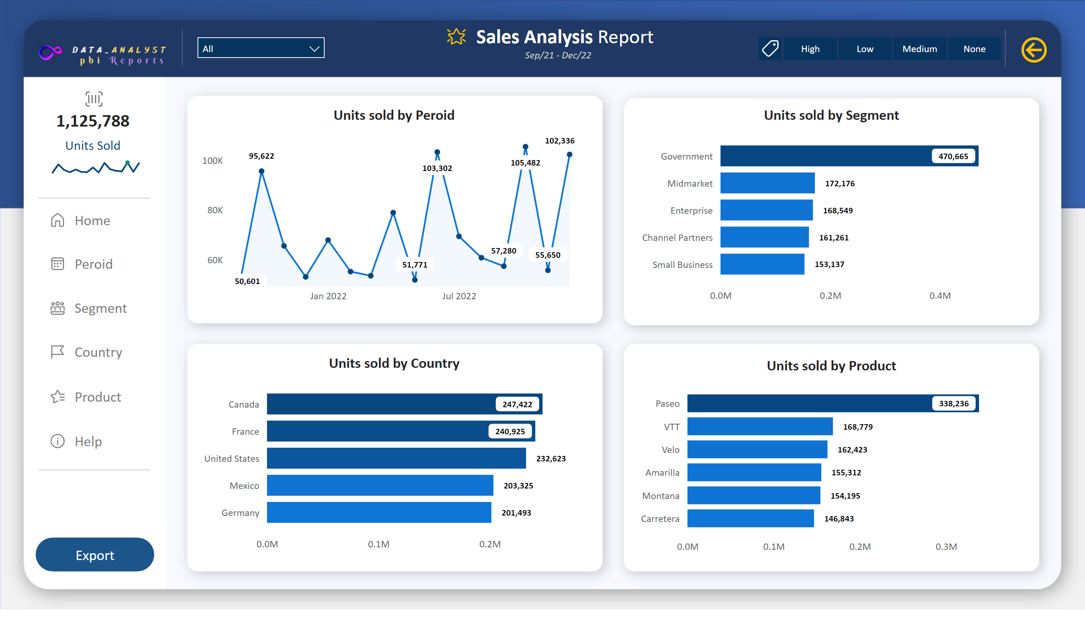
Units Sold
Notes:
Shape_Top_nav_divider
No alt text provided
Card_Unit sold
No alt text provided
Sparkline_unit sold
No alt text provided
Button_unit_sold_icon
No alt text provided
Button_Home
No alt text provided
Button_Help
No alt text provided
Button_Peroid
No alt text provided
Button_Country
No alt text provided
Button_segment
No alt text provided
Button_Product
No alt text provided
actionButton
No alt text provided
actionButton
No alt text provided
actionButton
No alt text provided
actionButton
No alt text provided
actionButton
No alt text provided
actionButton
No alt text provided
actionButton
No alt text provided
actionButton
No alt text provided
Shape_Bottom_nav_divider
No alt text provided
Button_Export
No alt text provided
Button_Title_Icon
No alt text provided
Slicer_manager
No alt text provided
Button_Logo
No alt text provided
Text box_Title
No alt text provided
Card_Date_Range
No alt text provided
Button_Discount_Icon
No alt text provided
Slicer_Discounts
No alt text provided
Button_Clear_Discounts
No alt text provided
Shape_Divider_left
No alt text provided
Shape_Divider_Right
No alt text provided
Units sold by Peroid
No alt text provided
Units sold by Segment
No alt text provided
Units sold by Country
No alt text provided
Units sold by Product
No alt text provided

Slide 6
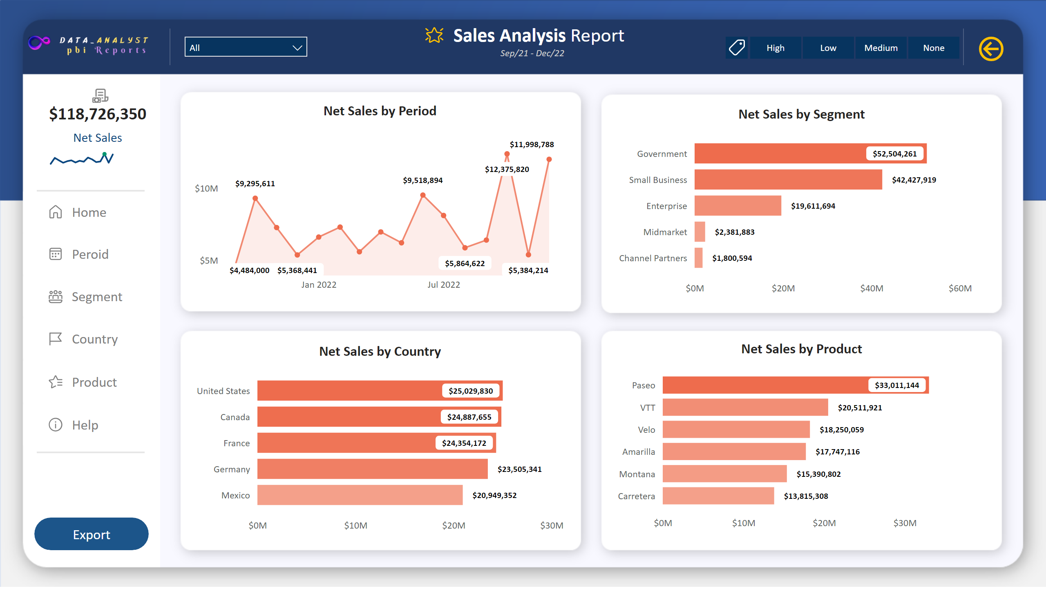
Net Sales
Notes:
Shape_Top_nav_divider
No alt text provided
Card_Net sales
No alt text provided
Sparkline_net sales
No alt text provided
Button_Net_sales_icon
No alt text provided
Button_Home
No alt text provided
Button_Help
No alt text provided
Button_Peroid
No alt text provided
Button_Country
No alt text provided
Button_segment
No alt text provided
Button_Product
No alt text provided
actionButton
No alt text provided
actionButton
No alt text provided
actionButton
No alt text provided
actionButton
No alt text provided
actionButton
No alt text provided
actionButton
No alt text provided
actionButton
No alt text provided
actionButton
No alt text provided
Shape_Bottom_nav_divider
No alt text provided
Button_Export
No alt text provided
Button_Title_Icon
No alt text provided
Slicer_manager
No alt text provided
Button_Logo
No alt text provided
Text box_Title
No alt text provided
Card_Date_Range
No alt text provided
Button_Discount_Icon
No alt text provided
Slicer_Discounts
No alt text provided
Button_Clear_Discounts
No alt text provided
Shape_Divider_left
No alt text provided
Shape_Divider_Right
No alt text provided
Net Sales by Product
No alt text provided
Net Sales by Country
No alt text provided
Net Sales by Segment
No alt text provided
Net Sales by Period
No alt text provided

Slide 7
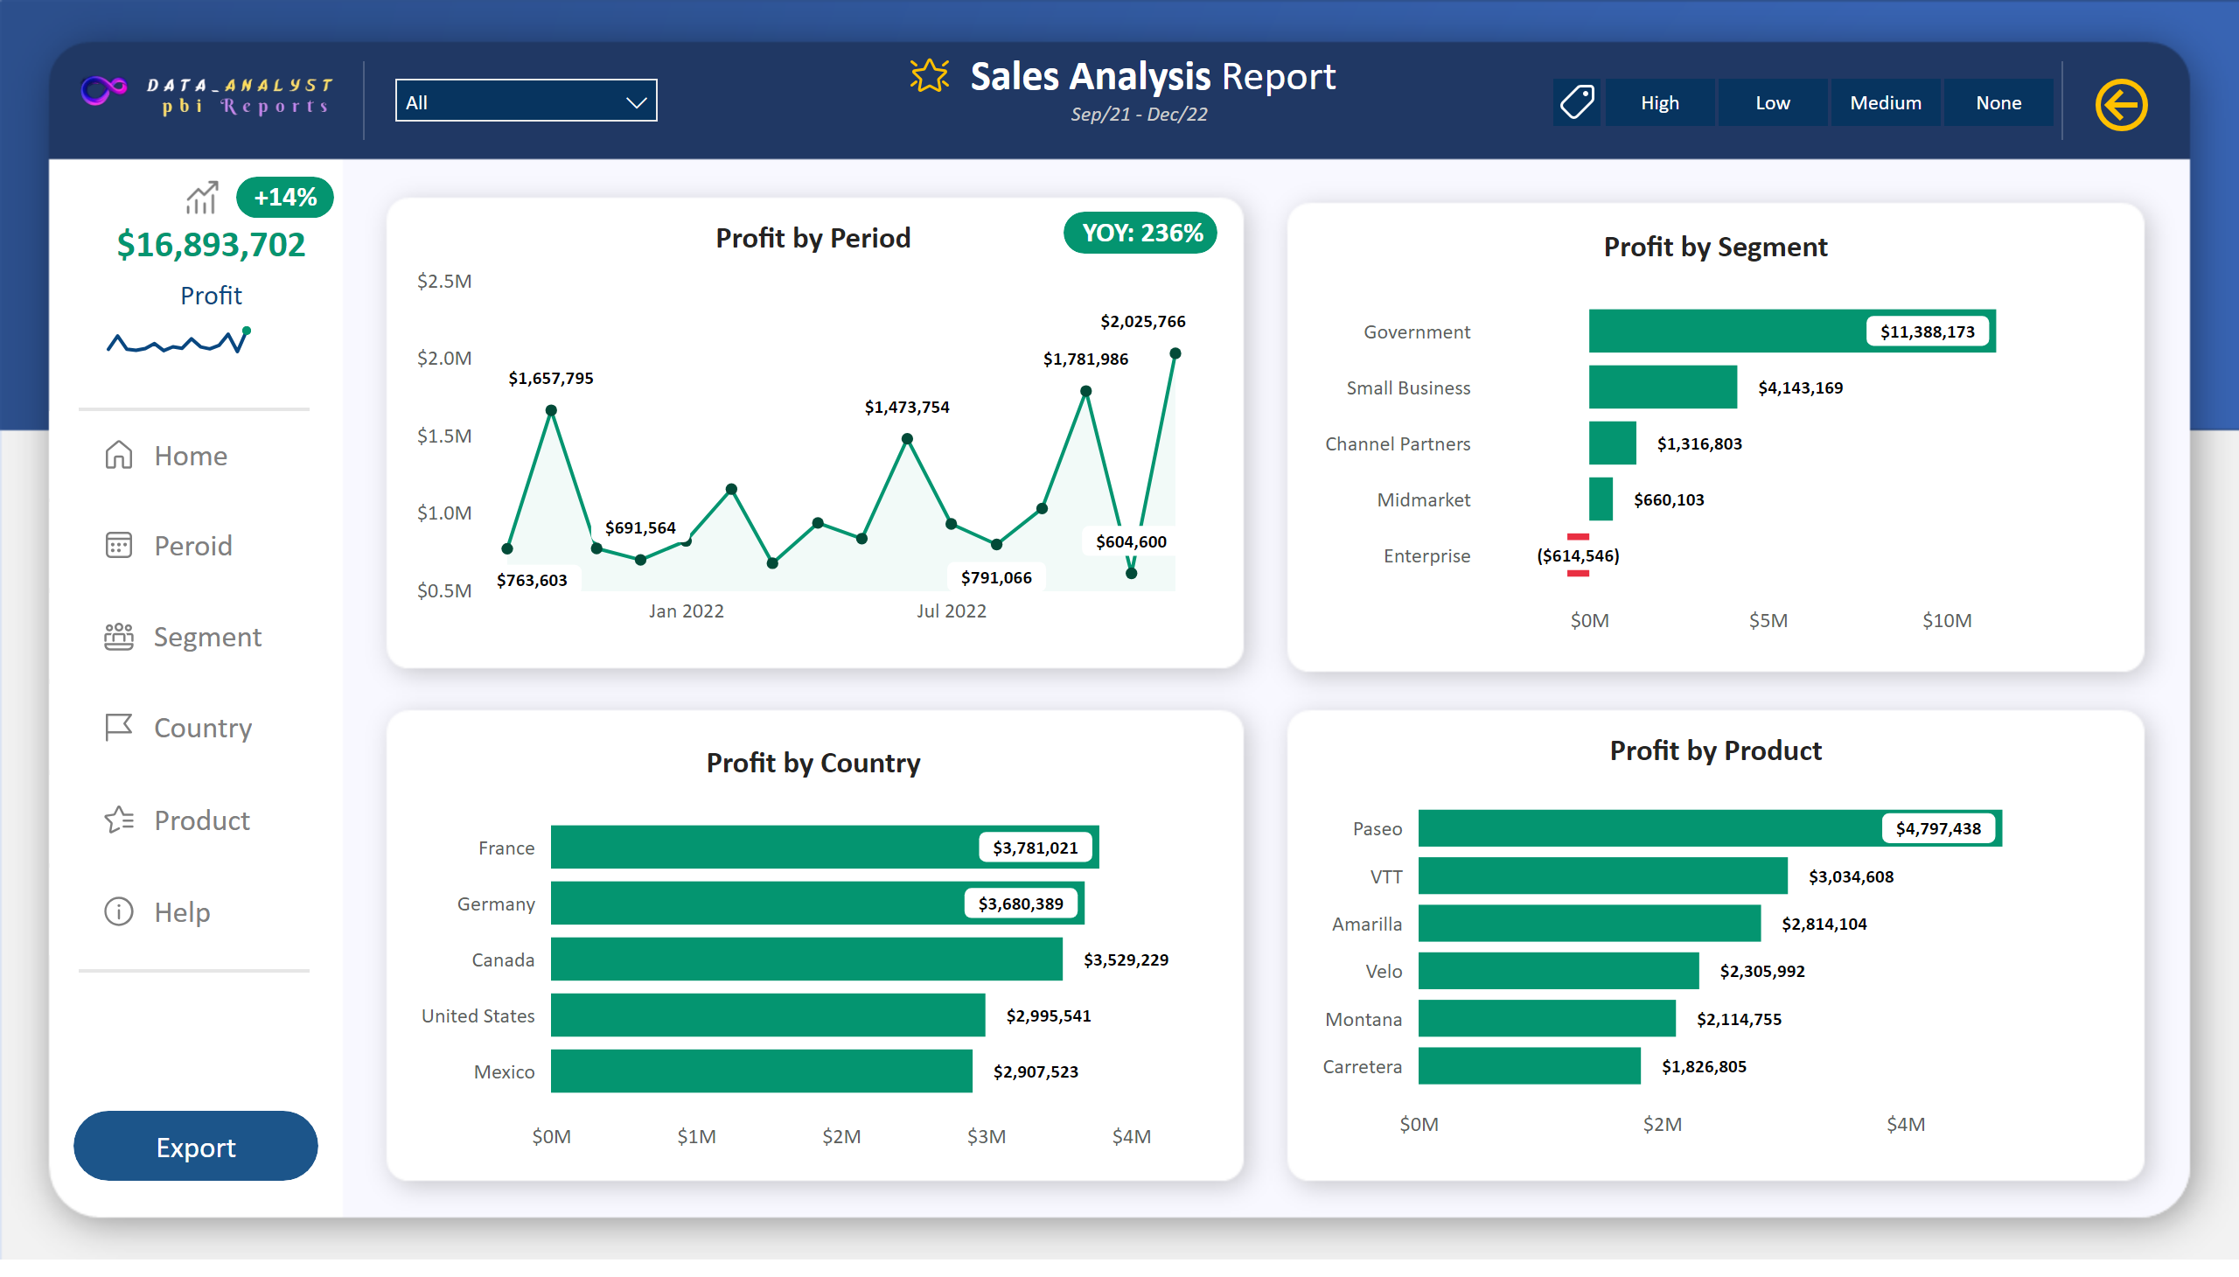
Net Profit
Notes:
Shape_Top_nav_divider
No alt text provided
Card_Profit_Mragin
No alt text provided
Shape_Profit_Margin
No alt text provided
Button_Profit_icon
No alt text provided
Card_Profit
No alt text provided
Sparkline_Profit
No alt text provided
Button_Home
No alt text provided
Button_Help
No alt text provided
Button_Peroid
No alt text provided
Button_Country
No alt text provided
Button_segment
No alt text provided
Button_Product
No alt text provided
actionButton
No alt text provided
actionButton
No alt text provided
actionButton
No alt text provided
actionButton
No alt text provided
actionButton
No alt text provided
actionButton
No alt text provided
actionButton
No alt text provided
actionButton
No alt text provided
Shape_Bottom_nav_divider
No alt text provided
Button_Export
No alt text provided
Button_Title_Icon
No alt text provided
Slicer_manager
No alt text provided
Button_Logo
No alt text provided
Text box_Title
No alt text provided
Card_Date_Range
No alt text provided
Button_Discount_Icon
No alt text provided
Slicer_Discounts
No alt text provided
Button_Clear_Discounts
No alt text provided
Shape_Divider_left
No alt text provided
Shape_Divider_Right
No alt text provided
Card_Profit_YOY
No alt text provided
Shape_Profit_YOY
No alt text provided
Profit by Product
No alt text provided
Profit by Period
No alt text provided
Profit by Country
No alt text provided
Profit by Segment
No alt text provided

Slide 8
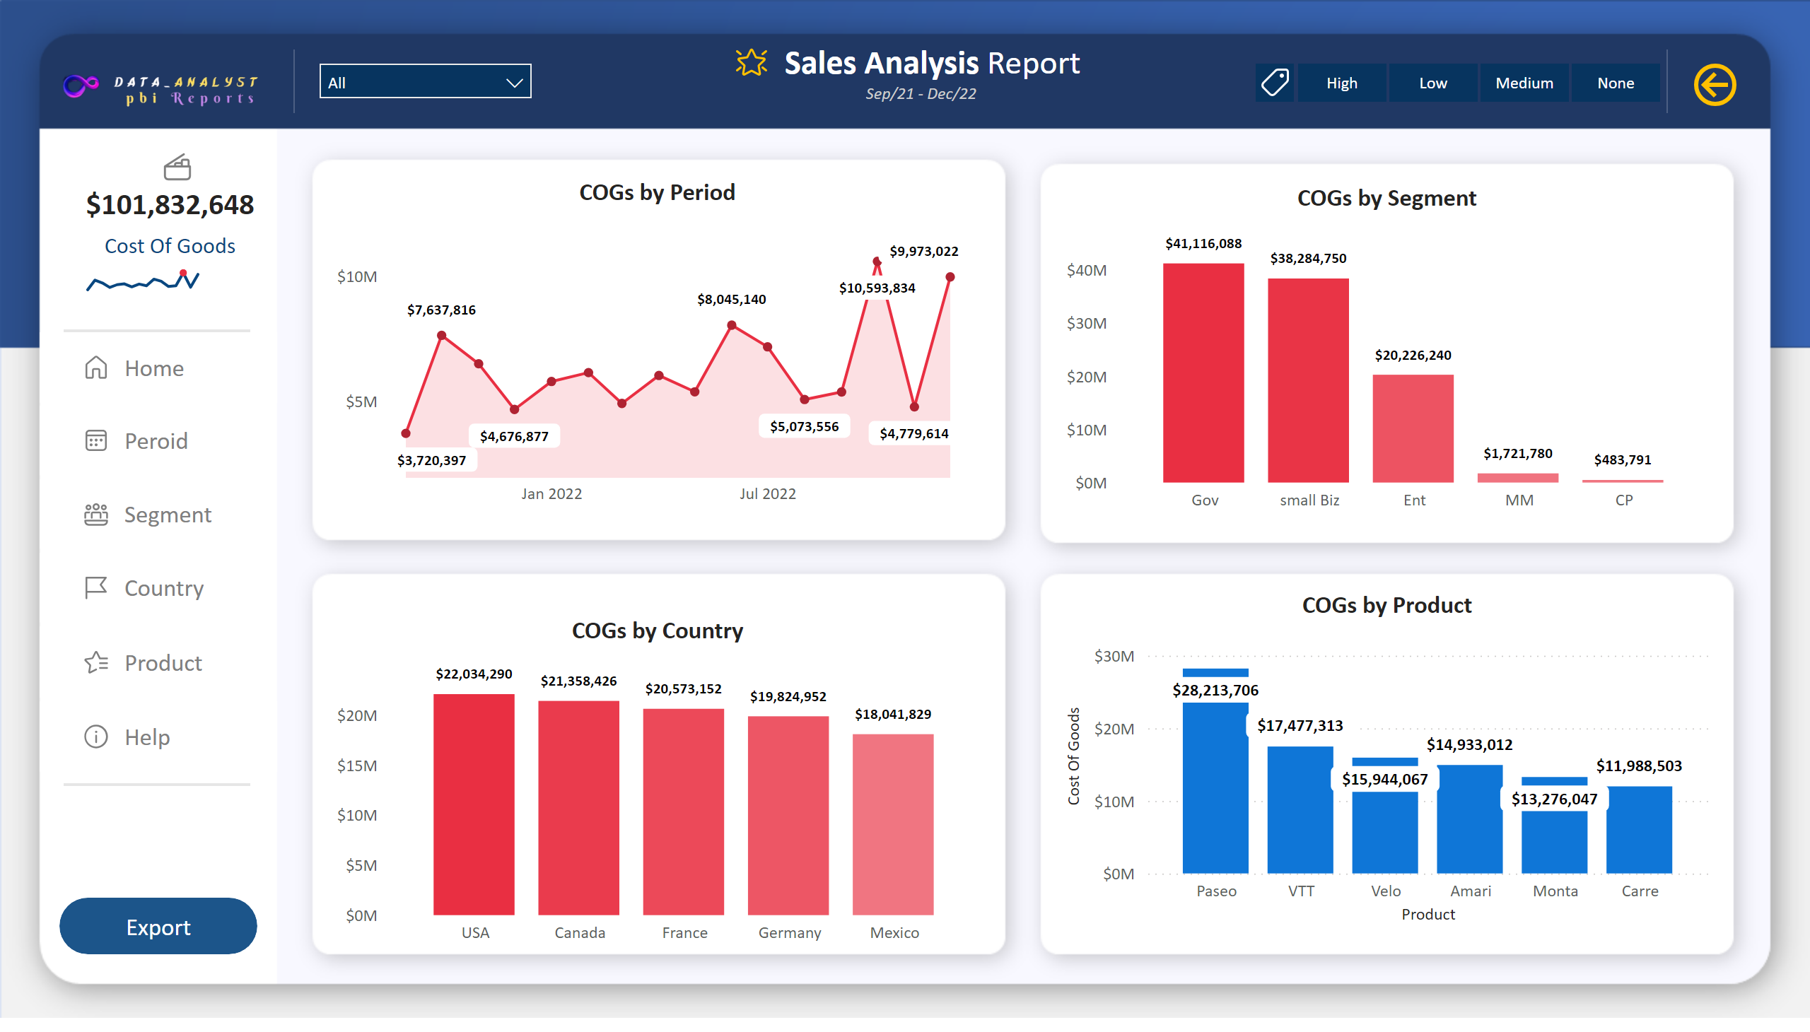
Cost of Goods
Notes:
Shape_Top_nav_divider
No alt text provided
Card_COGS
No alt text provided
Button_COGS_icon
No alt text provided
Sparkline_COGs
No alt text provided
Button_Home
No alt text provided
Button_Help
No alt text provided
Button_Peroid
No alt text provided
Button_Country
No alt text provided
Button_segment
No alt text provided
Button_Product
No alt text provided
actionButton
No alt text provided
actionButton
No alt text provided
actionButton
No alt text provided
actionButton
No alt text provided
actionButton
No alt text provided
actionButton
No alt text provided
actionButton
No alt text provided
actionButton
No alt text provided
Shape_Bottom_nav_divider
No alt text provided
Button_Export
No alt text provided
Button_Title_Icon
No alt text provided
Slicer_manager
No alt text provided
Button_Logo
No alt text provided
Text box_Title
No alt text provided
Card_Date_Range
No alt text provided
Button_Discount_Icon
No alt text provided
Slicer_Discounts
No alt text provided
Button_Clear_Discounts
No alt text provided
Shape_Divider_left
No alt text provided
Shape_Divider_Right
No alt text provided
COGs by Period
No alt text provided
COGs by Product
No alt text provided
COGs by Country
No alt text provided
COGs by Segment
No alt text provided

Slide 9
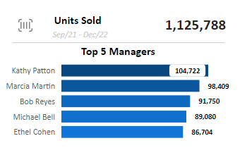
Tooltips: Units Sold
Notes:
Units sold by Product
No alt text provided
textbox
No alt text provided
shape
No alt text provided
textbox
No alt text provided
Card_Unit sold
No alt text provided
Card_Date_Range
No alt text provided
Button_unit_sold_icon
No alt text provided

Slide 10
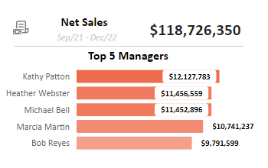
Tooltips: Net Sales
Notes:
Net Sales by Product
No alt text provided
textbox
No alt text provided
shape
No alt text provided
Card_Net sales
No alt text provided
textbox
No alt text provided
Card_Date_Range
No alt text provided
Button_Net_sales_icon
No alt text provided

Slide 11
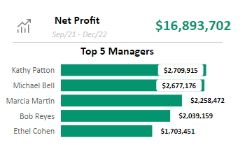
Tooltips: Net Profit
Notes:
Profit by Product
No alt text provided
textbox
No alt text provided
shape
No alt text provided
Card_Profit
No alt text provided
textbox
No alt text provided
Card_Date_Range
No alt text provided
Button_Profit_icon
No alt text provided

Slide 12
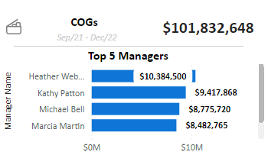
Tooltips: COGs
Notes:
COGs by Product
No alt text provided
textbox
No alt text provided
shape
No alt text provided
Card_COGS
No alt text provided
textbox
No alt text provided
Card_Date_Range
No alt text provided
Button_COGS_icon
No alt text provided

